Slide 1
Multi-Tenant Accounting
Blueprint for Data Contracts to manage multi-tenancy in OpenStack
Prepared for: Open Stack Summit – Nov 2010
By: Ziad Sawalha / Rackspace Architecture
Date: Nov 3, 2010

Slide 2
Agenda
What are we trying to solve?
The proposed solution
Q&A

Slide 3
Our Assumptions
OpenStack will be deployed by different ‘operators’
  Ex: enterprises, institutions, service providers, developers, etc…

Slide 4
Our Assumptions
OpenStack will be deployed by different ‘operators’
  Ex: enterprises, institutions, service providers, developers, etc…
You cannot make assumptions about the environment you will deploy to
  Can’t assume an authentication system: LDAP, Active Directory, etc…
  Cannot anticipate the definition of a ‘tenant’:
    Institutions may have departments
    Enterprises have unique organizational structures
    Service Providers have unique reseller and customer hierarchies
  Cannot predict the operator’s chargeback needs:
    Some IT organizations will absorb the cost of running their Stack
    Some may charge back usage to cost centers
    Service providers may charge resellers, customers, bill end-users on behalf of resellers, or even bill users directly!

Slide 5
Some of our design principles
Separation of concerns
  Operators own their business logic and organizational hierarchy
  Conversely, services must remain free of operator-specific business logic
  Operator ‘business logic’ should be decoupled from OpenStack service design
  Decoupled systems need clearly defined contracts
Keep it simple
  Consider what a minimum implementation for a service should be considered
  Minimize requirements for tenant metadata

Slide 6
A model solution exists today…
SWIFT supports multiple tenant models
  Rackspace Cloud (formerly Mosso)
  JungleDisk
Both have tenants in one deployment of SWIFT
SWIFT:
  calls uses the term ‘account’ for a tenant
  does not attach ‘meaning’ to what an account is
  accepts accounts as operator-provided, arbitrary strings
  reports the account string in it’s usage logs
  has the capability to perform authorization on an account
Nova has the concept of ‘projects’

Slide 7
Proposal
Use the SWIFT model to develop formal contracts
Solution:
Tenant is just an arbitrary string.
CRUD on tenants belongs on Admin API (looks like a collection)
Call it an ‘Account’
Three integration points:
  Collection CRUD on Admin API
  Consumer URLs contain the account
  Output account in raw logs

Slide 8
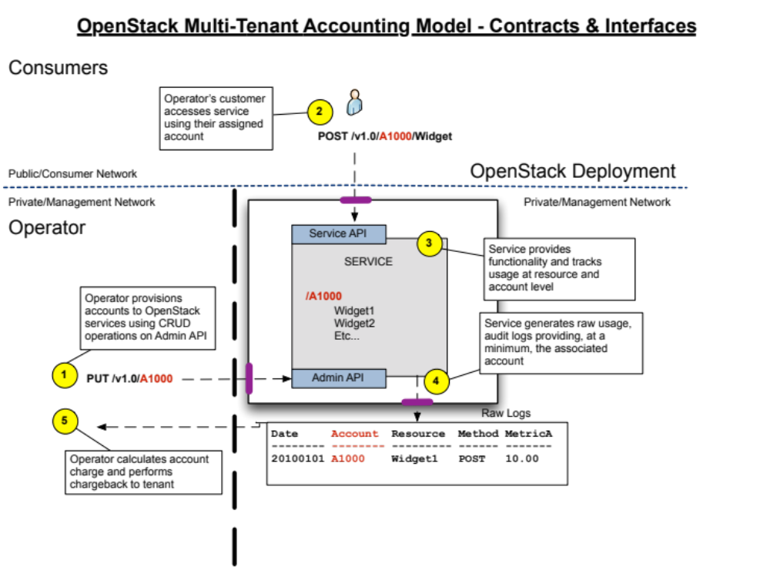

Slide 9
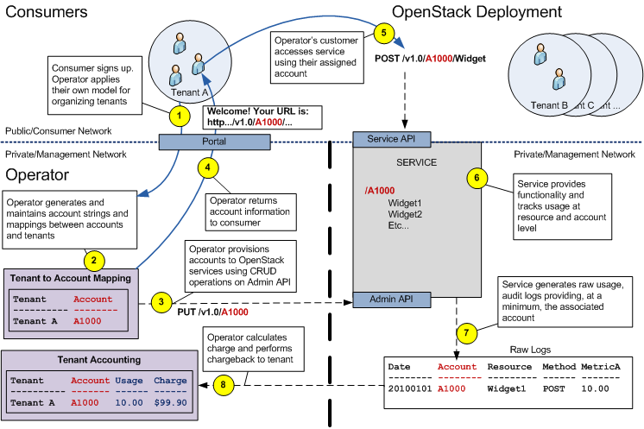

Slide 10
Tenants vs. Accounts
This blueprint does not fix the definition of tenant. The focus is on the concept of the ‘account’ in an OpenStack service and the data contracts and APIs dealing with accounts.
Tenant is an operator construct. It does not ‘bleed’ into the service architecture or implementation.
Account is an OpenStack service construct. It does exist in service code and architecture.
The operator determines how they want to map tenants to accounts:
  1:1 – one tenant = one account
  1:n – one tenant has many accounts
  n:1 – many tenants exist in a single account
  n:n – many tenants, many accounts, shared and mapping handled by operator

Slide 11
Thank you
https://blueprints.launchpad.net/nova/+spec/multi-tenant-accounting

Slide 12
Appendix: Aspects of Tenancy
Isolation: The ability to isolate one tenant from another
  Security: isolate tenants into separate security domains
  Performance: ability to provide performance guarantees (floor, ceiling) to tenant. Protecting tenants from their ‘neighbors’.
  Portability: ability to move one tenant’s resources, data, and/or workload.
Accounting: Usage Tracking
  The ability to track the usage per tenant (and per resource). Therefore, also tracking which tenant a resource belongs to.
  Providing reports per-tenant.
Auditing
  Tracking events per tenant
  Providing audit logs per-tenant

